Slide 1
Catching up with JS - I
Followings return true in conditions
Object , Non-Empty String , Non-Zero , true
Followings return false in conditions
Undefined, Null , Zero , Empty String, false

Slide 2
Catching up with JS - II
Frames are so cool...! Because when you use them, you can exchange resources between each other.
instanceof Array
vs
Array.isArray

Slide 3

Welcome to Advanced Java Script
Stage 1

Slide 4

4 built-in Reference Types that have literal notation
Arrays
RegExp
Object
Function

Slide 5
RegExp - Regular Expressions
Usage :
var exp = new RegExp ( 'pattern' , flags)
var exp = / pattern / flags
Literal Notation
Flags :
g : global match; don't stop after the first match
i : ignore case
m : multiline

Slide 6
Regular Expressions Quick Recap - I
\ s
\ d
\ w
\ b
\ S
\ D
\ W
\ B
Any white space
! Any white space
Any digit
! Any digit
[A-Z] [a-z] [0-9] _
! [A-Z] [a-z] [0-9] _
Any word boundary
! Any word boundary

Slide 7
Regular Expressions Quick Recap - II
.
[bac]
[^abc]
[A-Z]
[a-g]
[0-9]
[A-Za-z0-9]
Match anything
Match all "b", "a" & "c"
Match anything expect "b", "a" & "c"
Match A to Z
Match a to g
Match 0 to 9
Match A to Z, a-z, 0-9

Slide 8
Regular Expressions Quick Recap - III
?
*
+
{n}
{n , m}
{n , }
0 or 1
0 or More
1 or More
Preceding Whatever
Times
Exactly n
Between n and m
n or More

Slide 9
Regular Expressions Quick Recap - IV
^
$
( )
|
Mark, begining of a string
Mark, end of a string
Group, regular expressions
OR

Slide 10
Important RegExp Methods in JS
RegExp.test ( String )
String.match( RegExp )

Slide 11
4 built-in Reference Types that have literal notation
Arrays
RegExp
Object
Function

Slide 12
Object ( Literal & Constructor )
Usage :
var obj = { }
var obj = new Object ();

Slide 13
4 built-in Reference Types that have literal notation
Arrays
RegExp
Object
Function

Slide 14
Function ( Literal & Constructor )
Usage :
(1) function myFunction ( ) {
}
(2) var myFn = function ( ) {
}
var myFn = new Function( [ arg1, ... ] , function body );
Declaration
Expression

Slide 15
4 built-in Reference Types that have literal notation
Arrays
RegExp
Object
Function

Slide 16
JS is all about Objects

Slide 17
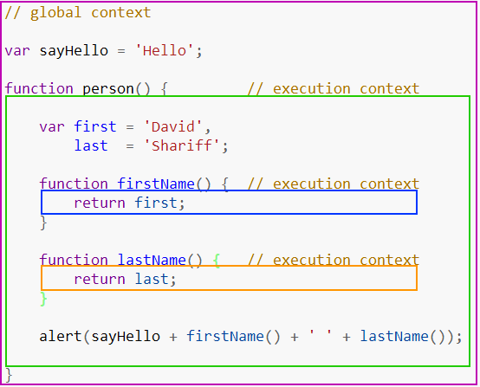
Execution Context

Slide 18
Dot Notation vs Bracket Notation
. vs [ ]

Slide 19
2 Kind of Properties that Objects have
Own Properties
Prototype Properties

Slide 20
(Own vs Prototype) Properties
.hasOwnProperty ( " property name " ) :: boolean
var properties = Object.keys ( object ) ;

Slide 21
Two Types of Properties
Data Properties
Accessor Properties

Slide 22
_ (Underscore)
_ is used to indicate something private. So don't access it directly.
__ is used to indicate something really.. really... really... private. Generally use by JS engine.

